Slide 1
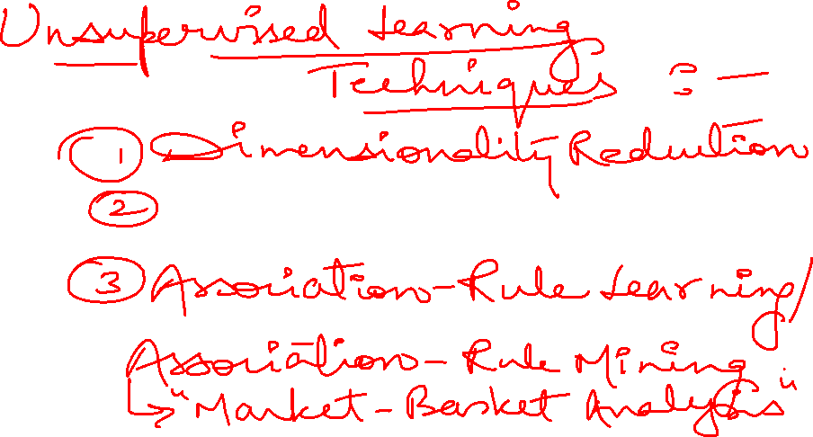
Clustering

Slide 2
What is Clustering?
A way of grouping together data samples that are similar in some way - according to some criteria that you pick.
A form of unsupervised learning – you generally don’t have examples demonstrating how the data should be grouped together
So, it’s a method of data exploration – a way of looking for patterns or structure in the data that are of interest

Slide 3
Clustering Applications
Biology: taxonomy of living things: kingdom, phylum, class, order, family, genus and species
Information retrieval: document clustering
Land use: Identification of areas of similar land use in an earth observation database

Slide 4
Clustering Applications (Contd.)
Marketing: Help marketers discover distinct groups in their customer bases, and then use this knowledge to develop targeted marketing programs.
City-planning: Identifying groups of houses according to their house type, value, and geographical location.
Climate: understanding earth climate, find patterns of atmospheric and ocean.

Slide 5
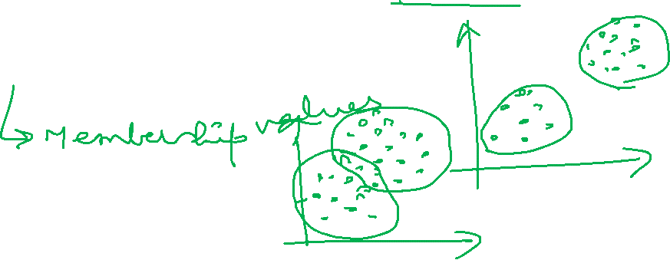
Clustering Algorithms
Exclusive Clustering (Partitioning Methods/ Hard Clustering)
eg: k-means, k-medoids, CLARANS
Overlapping Clustering (Soft Clustering)
eg: Fuzzy/ c- means
Hierarchical Clustering
eg: agglomerative, divisive

Slide 6
Clustering Algorithms (Contd.)
Density Based Clustering
eg: DBSCAN, OPTICS, DenClue
Grid Based Clustering
eg: STING, WaveCluster, CLIQUE

Slide 7
How do we define “similarity”?
The goal is to group together “similar” data – but what does this mean?
No single answer – it depends on what we want to find or emphasize in the data; this is one reason why clustering is an “art”.
The similarity measure is often more important than the clustering algorithm used.

Slide 8
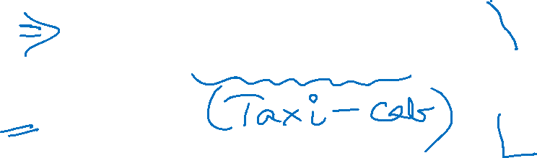
Distance (dissimilarity) measures
Euclidean Distance
Mahattan Distance

Slide 9
k-Means Clustering
k-means (MacQueen, 1967) is a partitional clustering algorithm.
Let the set of data points D be {x₁ , x₂ , …, x_{n} }, where x_{i} = (x_{i1} , x_{i2} , …, x_{ir}) is a vector in X⊆R^{r} , and r is the number of dimensions.
The k-means algorithm partitions the given data into k clusters. Each cluster has a cluster center, called centroid.

Slide 10
k-means Clustering Algorithm
Given k, the k-means algorithm works as follows:
Choose k (random) data points (seeds) to be the initial centroids, cluster centers
Assign each data point to the closest centroid
Re-compute the centroids using the current cluster memberships
If a convergence criterion is not met, repeat steps 2 and 3

Slide 11
k-means Convergence (Stopping) Criterion
no (or minimum) re-assignments of data points to different clusters, or
no (or minimum) change of centroids, or
minimum decrease in the Sum of Squared Error (SSE).

Slide 12
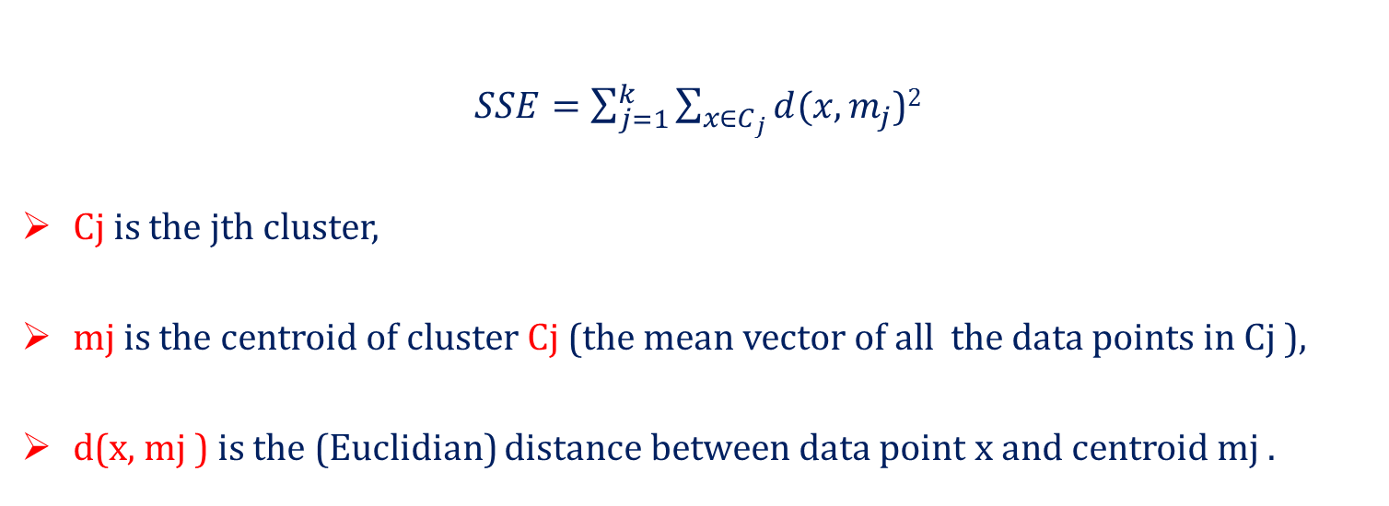
Sum of Squared Error (SSE)
$SSE=\sum_{j=1}^{k}{\sum_{x∈C_{j}}{d(x,m_{j}}}$)²
Cj is the jth cluster,
mj is the centroid of cluster Cj (the mean vector of all the data points in Cj ),
d(x, mj ) is the (Euclidian) distance between data point x and centroid mj .

Slide 13
An Example of k-Means Clustering
Partition objects into k nonempty subsets
K=2
Arbitrarily partition objects into k groups
Update the cluster centroids
Repeat
Loop if needed
Reassign objects
Compute centroid (i.e., mean point) for each partition
Assign each object to the cluster of its nearest centroid
Until no change
Update the cluster centroids

Slide 14
Why use K-means?
Strengths:
Simple: easy to understand and to implement
K-means is the most popular clustering algorithm.

Slide 15
Weaknesses of K-means
The user needs to specify k.
The algorithm is sensitive to outliers
– Outliers are data points that are very far away from other data points.
Random initialization means that you may get different clusters each time.
Can be slow for large number of samples

Slide 16
Outliers
a) Undesirable Clusters
b) Desirable Clusters

Slide 17
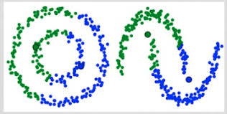
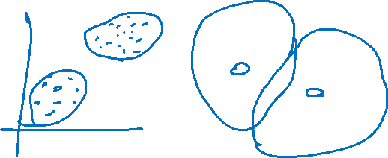
Special Data Structures
The k-means algorithm is not suitable for discovering clusters that are not hyper-ellipsoids (or hyper-spheres).

Slide 18
Working Example of k-Means

Slide 19

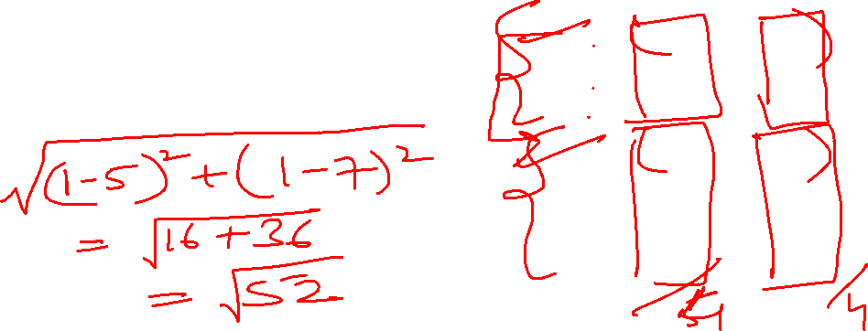
K-Means: Step-by-Step Example
Subject | A | B
1 | 1.0 | 1.0
2 | 1.5 | 2.0
3 | 3.0 | 4.0
4 | 5.0 | 7.0
5 | 3.5 | 5.0
6 | 4.5 | 5.0
7 | 3.5 | 4.0
Consider the following data set consisting of the scores of two variables on each of seven individuals:

Slide 20
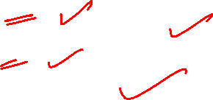
This data set is to be grouped into two clusters.
The remaining individuals are now examined in sequence and allocated to the cluster to which they are closest, in terms of Euclidean distance to the cluster mean.
 | Individual | Mean Vector (centroid)
Group 1 | 1 | (1.0, 1.0)
Group 2 | 4 | (5.0, 7.0)

Slide 21
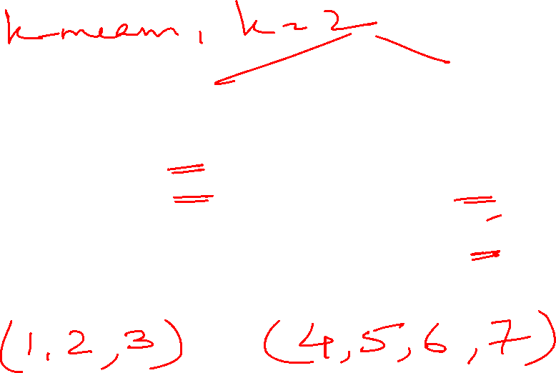
Individual | Distance to mean (centroid) of Cluster 1 | Distance to mean (centroid) of Cluster 2
1 | 0 | 7.21
2 | 1.12 | 4.15
3 | 3.6 | 3.6
4 | 7.21 | 0
5 | 4.72 | 2.5
6 | 5.32 | 2.06
7 | 3.91 | 3.35

Slide 22
Cluster 1 |  | Cluster 2
Individual | Mean Vector (centroid) | Individual | Mean Vector (centroid)
1, 2, 3 | (1.8, 2.3) | 4, 5, 6, 7 | (4.1, 5.4)

Slide 23
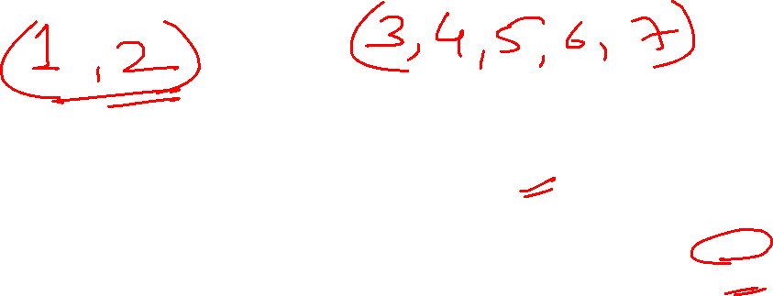
Individual | Distance to mean (centroid) of Cluster 1 | Distance to mean (centroid) of Cluster 2
1 | 1.5 | 5.4
2 | 0.4 | 4.3
3 | 2.1 | 1.8
4 | 5.7 | 1.8
5 | 3.2 | 0.7
6 | 3.8 | 0.6
7 | 2.8 | 1.1
Now, again we compare each individual’s distance to its own cluster mean and to that of the opposite cluster.
Only individual 3 is nearer to the mean of the opposite cluster (Cluster 2) than its own (Cluster 1).

Slide 24

Thus, individual 3 is relocated to Cluster 2 resulting in the new partition.
The iterative relocation would now continue from this new partition until no more relocations occur.
 | Individual | Mean Vector (centroid)
Cluster 1 | 1, 2 | (1.3, 1.5)
Cluster 2 | 3, 4, 5, 6, 7 | (3.9, 5.1)

Slide 25
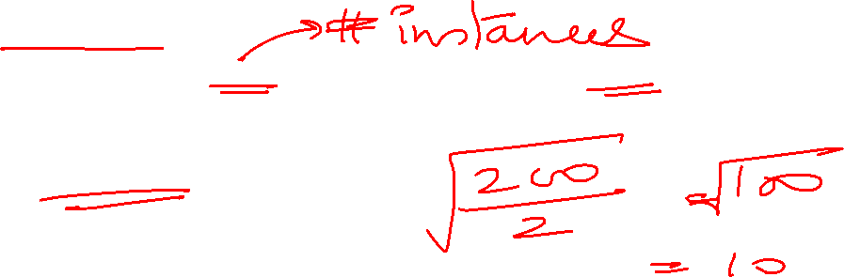
Determine the Number of Clusters
Empirical method
# of clusters: k ≈√n/2 for a dataset of n points, e.g., n = 200, k = 10
Other method:
Elbow method

Slide 26
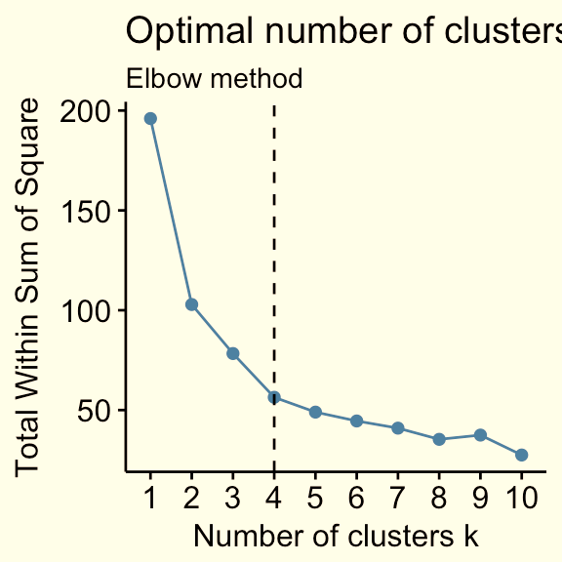
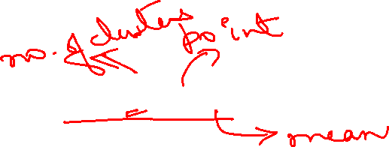
Elbow Method
The technique to determine k.
The total WSS measures the compactness of the clustering and we want it to be as small as possible.

Slide 27
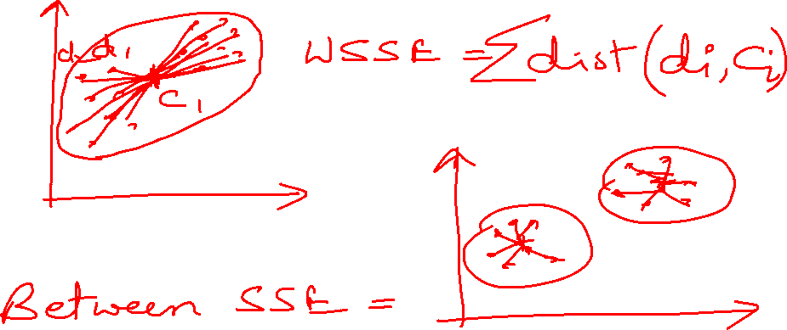
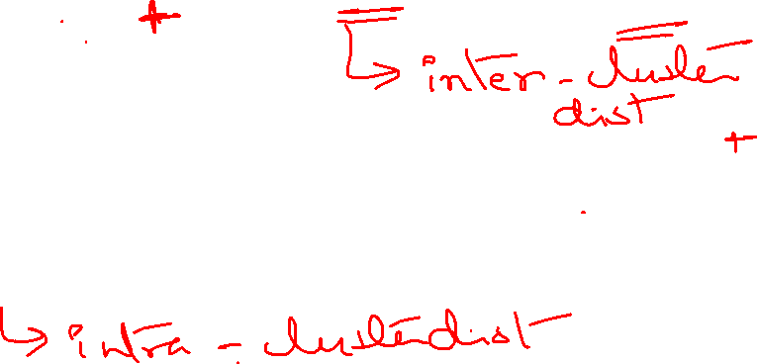

Slide 29
The Elbow method looks at the total WSS as a function of the number of clusters.
One should choose number of clusters so that adding another cluster doesn’t improve much better the total WSS.

Slide 30
Hierarchical Clustering
Produces a set of nested clusters organized as a hierarchical tree.
Hierarchical clustering may correspond to meaningful taxonomies.
Example: in biological sciences (e.g. Phylogeny, reconstruction, etc.), web (products catalog, etc.)

Slide 31
Types of Hierarchical Clustering
Hierarchical Clustering
Agglomerative
Divisive

Slide 32
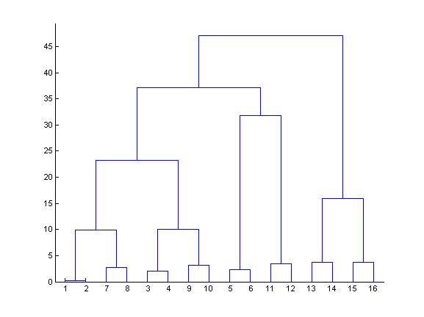
Dendogram
Hierarchical clustering can be visualized as a dendogram.
The final cluster is the root and each data item is a leaf.
The height of the bars indicate how close the items are.

Slide 33
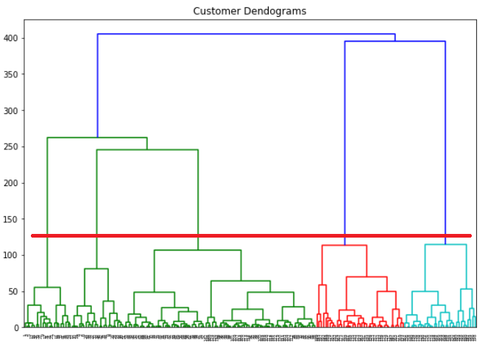
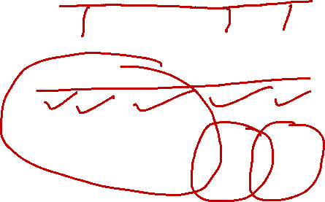
Dendogram
A clustering of the data objects is obtained by cutting the dendrogram at the desired level, then each connected component forms a cluster

Slide 34
Hierarchical Clustering Demo
Step 0
Step 1
Step 2
Step 3
Step 4
agglomerative
(AGNES)
a
a b
b
a b c d e
c
c d e
d
d e
e
divisive
(DIANA)
Step 4
Step 3
Step 2
Step 1
Step 0

Slide 35
Agglomerative Clustering
We start with every data point in a separate cluster.
We keep merging the most similar pairs of data points/clusters until we have one big cluster left.
This is called a bottom-up or agglomerative method.

Slide 36
Agglomerative Clustering Algorithm
Basic algorithm is straightforward
Compute the distance matrix
Let each data point be a cluster
Repeat
Merge the two closest clusters
Update the distance matrix
Until only a single cluster remains

Slide 37
Starting Situation
. .
Start with clusters of individual points and a distance matrix
 | p1 | p2 | p3 | p4 | p5 | .
p1
p2
p3
p4
p5
.
.
.
Distance Matrix

Slide 38
Intermediate Situation
After some merging steps, we have some clusters.
Choose two clusters that has the smallest distance (largest similarity) to merge.
t | C1 | C2 | C3 | C4 | C5
C1
C2
C3
C4
C5
C3
C4
C1
Distance Matrix
C2
C5

Slide 39
Intermediate Situation
We want to merge the two closest clusters (C2 and C5) and update the distance matrix.
 | C1 | C2 | C3 | C4 | C5
C1
C2
C3
C4
C5
C3
C4
C1
Distance Matrix
C2
C5

Slide 40
After Merging
The question is “How do we update the distance matrix?”
 | C1 | C2UC5 | C3 | C4
C1 |  | ?
C2 U C5 | ? | ? | ? | ?
C3 |  | ?
C4 |  | ?
C3
C4
C1
C2 U C5
Distance Matrix

Slide 41
How to Define Inter-Cluster Distance?
. .
 | p1 | p2 | p3 | p4 | p5 | .
p1
p2
p3
p4
p5
.
Distance?
MIN
MAX
Group Average
Distance Between Centroids
……
Distance Matrix

Slide 42
Answer IS….
Linkage Methods

Slide 43
Linkages
We already know about distance measures between data items, but what about between a data item and a cluster or between two clusters?
We just treat a data point as a cluster with a single item.
So our only problem is to define a linkage method between clusters.

Slide 44
Linkage Methods
Common Types of Linkage Methods
Single-Linkage
Complete-Linkage
Average-Linkage
Ward-Linkage

Slide 45
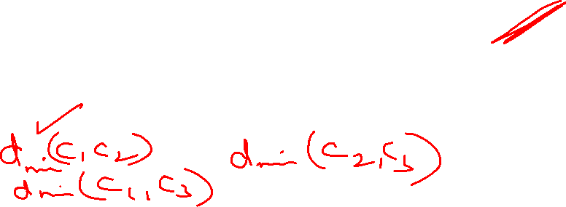
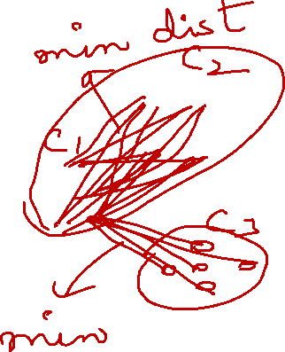
Single-Linkage
The minimum of all pairwise distances between points in the two clusters.
Tends to produce long, “loose” clusters.
d_{min} (C_{i} ,C_{j} ) =
min d ( p, q)
p∈C_{i} ,q∈C _{j}

Slide 46
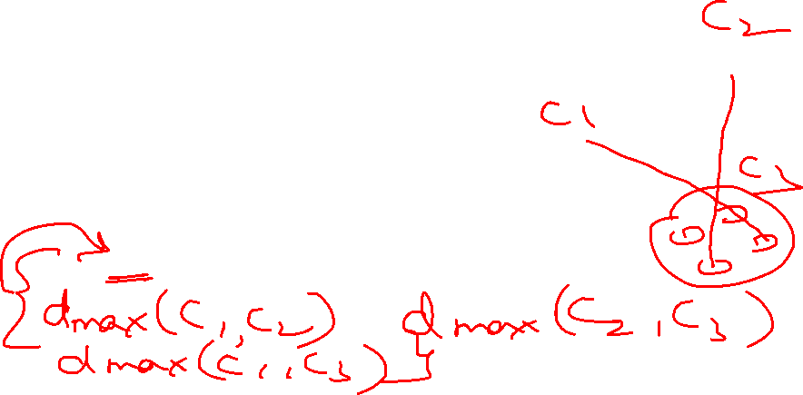
Complete-Linkage
The maximum of all pairwise distances between points in the two clusters.
Tends to produce very tight clusters
d_{min} (C_{i} ,C_{j} ) =
max d ( p, q)
p∈C_{i} ,q∈C _{j}

Slide 47
Average Linkage
Average linkage is defined as the average of all pairwise distances between points in the two clusters.
d_{min} (C_{i} ,C_{j} ) =
avg d ( p, q)
p∈C_{i} ,q∈C _{j}

Slide 48
Ward Linkage
Ward’s method says that the distance between two clusters: A and B, is how much the sum of squares will increase when we merge them.
Sum of the squares grows as we merge the clusters.
Ward’s method keeps this growth as small as possible.

Slide 50
Main Observations
single linkage is fast, and can perform well on non-spherical data. Single linkage pay attention solely to the area where the two clusters come closest to each other.
average and complete linkage perform well on cleanly separated spherical clusters, but have mixed results otherwise.
Ward is the most effective method for noisy data.

Slide 51
Measuring Quality of Clusters

Slide 52
What Is Good Clustering?
A good clustering method will produce high quality clusters with
high intra-class similarity
low inter-class similarity

Slide 53
Measure the Quality of Clustering
The quality of a clustering result depends on both the similarity measure used by the method and its implementation.
The quality of a clustering method is also measured by its ability to discover some or all of the hidden patterns.
Dissimilarity/Similarity metric: Similarity is expressed in terms of a distance function, which is typically metric: d(i, j)

Slide 54
Supervised Clusters Analysis Techniques
requires knowledge of the ground truth classes.
or requires manual assignment by human annotators.
Example: Rand Index, Fowlkes-Mallows scores, etc.

Slide 55
Rand Index
Given a set of n elements S= {o₁, o₂,…..,o_{n}} and let U and V represents two different partitions of S, such that U is the external criteria and V is a clustering result.
a be the number of the pairs of objects that are placed in the same class in U and in the same cluster as in V.
b be the number of the pairs of objects that are placed in the same class in U but not in the same cluster in V.

Slide 56
Rand Index contd.
c be the number of the pairs of objects that are placed in the same cluster in V but not in the same class in U.
d be the number of the pairs of objects that are in different classes and in different clusters in both partitions.
Rand Index is given as:
RI = a + d / (a + b + c + d)

Slide 57
Rand Index contd.
Bounded range [0, 1]: 1.0 is the perfect match score.

Slide 58
Unsupervised Clusters Analysis Techniques
If the ground truth labels are not known, evaluation must be performed using the model itself.
Example: Silhouette Coefficient, Davies-Bouldin Index, etc.

Slide 59
Silhouette Coefficient
Silhouette Coefficient is defined for each sample and is composed of two scores:
a: The mean distance between a sample and all other points in the same class.
b: The mean distance between a sample and all other points in the next nearest cluster.

Slide 60
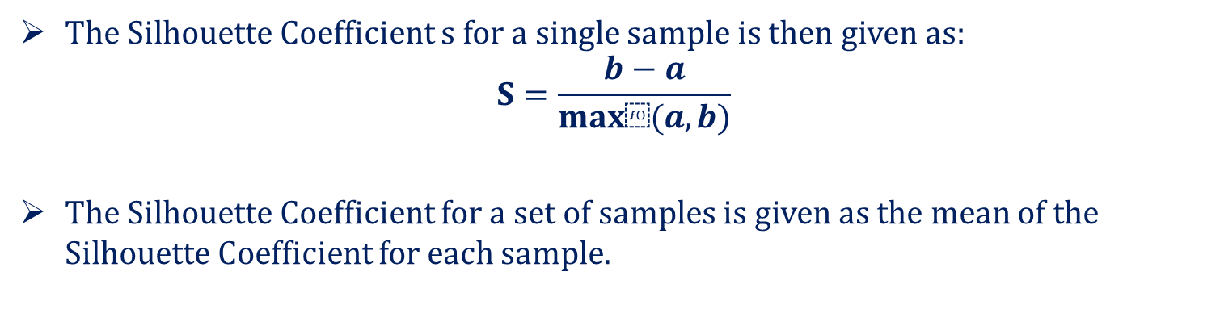
Silhouette Coefficient contd.
The Silhouette Coefficient s for a single sample is then given as:
$$S=\frac{b−a}{max⁡(a,b)}$$
The Silhouette Coefficient for a set of samples is given as the mean of the Silhouette Coefficient for each sample.

Slide 61
Silhouette Coefficient contd.
The score is bounded between -1 for incorrect clustering and +1 for highly dense clustering. Scores around zero indicate overlapping clusters.
The score is higher when clusters are dense and well separated, which relates to a standard concept of a cluster.

Slide 62
DBSCAN
Density-based spatial clustering of applications with noise (DBSCAN): Clusters are dense regions in the data space, separated by regions of the lower density of points.
The key idea is that for each point of a cluster, the neighborhood of a given radius must contain at least a minimum number of points.

Slide 63
Why DBSCAN?
Partitioning methods (K-means, PAM clustering) and hierarchical clustering work for finding spherical-shaped clusters or convex clusters.
In other words, they are suitable only for compact and well-separated clusters.
Moreover, they are also severely affected by the presence of noise and outliers in the data.

Slide 64
DBSCAN algorithm requires two parameters:
eps : It defines the neighborhood around a data point i.e. if the distance between two points is lower or equal to ‘eps’ then they are considered as neighbors. If the eps value is chosen too small then large part of the data will be considered as outliers. If it is chosen very large then the clusters will merge and majority of the data points will be in the same clusters. One way to find the eps value is based on the k-distance graph.
MinPts: Minimum number of neighbors (data points) within eps radius. Larger the dataset, the larger value of MinPts must be chosen. As a general rule, the minimum MinPts can be derived from the number of dimensions D in the dataset as, MinPts >= D+1. The minimum value of MinPts must be chosen at least 3.

Slide 65
In this algorithm, we have 3 types of data points:
Core Point: A point is a core point if it has more than MinPts points within eps.
Border Point: A point which has fewer than MinPts within eps but it is in the neighborhood of a core point.
Noise or outlier: A point which is not a core point or border point.

Slide 66
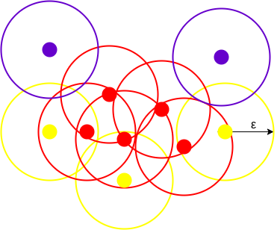
This figure shows us a cluster created by DBCAN with minPoints = 3. Here, we draw a circle of equal radius epsilon around every data point.
All the data points with at least 3 points in the circle including itself are considered as Core points represented by red color.
All the data points with less than 3 but greater than 1 point in the circle including itself are considered as Border points. They are represented by yellow color.
Finally, data points with no point other than itself present inside the circle are considered as Noise represented by the purple color.

Slide 67
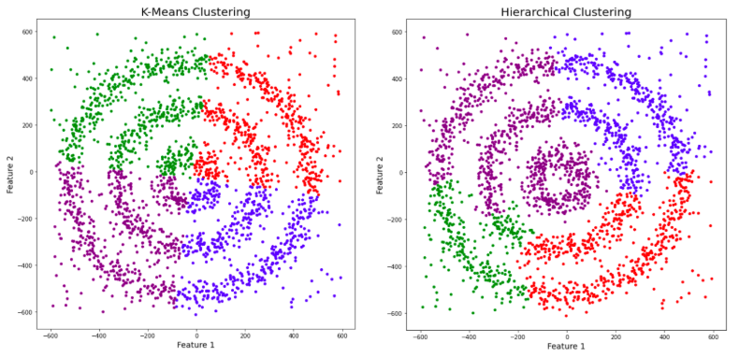
Example to compare cluster formation by different clustering algorithms:

Slide 68
